Slide 1
Retail Sales Analytics
By: Srimathi K

Slide 2
PROBLEM STATEMENT
ABC Electronics wants to evaluate sales performance across regions and product categories.
The management needs visual insights to identify:
Top-performing regions
Product trends
Effect of discounts on profitability
Objective: To clean, analyze, and visualize sales data for actionable business insights.

Slide 3
TASKS:
TASK 1 & 2:
Data Cleaning and Pre processing:
Order ID | Order Date | Region | Product Category | Sales Amount | Quantity Sold | Discount (%) | Profit
ab899d2f | 2023-04-06 | norTh | groceries | 859.29 | 44 | 37 | 1653.87
73484eb1 | 2024-04-30 | Mes$t | groceries | 1546.81 | 23 | 33 | 1932.71
19395924 | 2024-03-12 | eAsT | groceries | 4703.58 | 31 | 15 | 527.47
b3fded3d | 2024-02-09 | eAsT | groceries | 3377.17 | 47 | 3 | 482.65
6e4bdd51 | 2024-07-29 | $0uTH | Cloth ing | 3517.49 | 6 | 28 | 748.72
21d88d69 | 2023-08-26 | eAsT | FURNiture | 362.55 | 19 | 50 | 314.71
9da2704d | 2024-10-07 | eAsT | sports | 4811.17 | 22 | 18 | 1372.89
Order ID | Order Date | Region | Product Category | Sales Amount | Quantity Sold | Discount (%) | Profit
ab899d2f | 2023-04-06 | North | Groceries | 859.29 | 44 | 37 | 1653.87
73484eb1 | 2024-04-30 | West | Groceries | 1546.81 | 23 | 33 | 1932.71
19395924 | 2024-03-12 | East | Groceries | 4703.58 | 31 | 15 | 527.47
b3fded3d | 2024-02-09 | East | Groceries | 3377.17 | 47 | 3 | 482.65
6e4bdd51 | 2024-07-29 | South | Clothing | 3517.49 | 6 | 28 | 748.72
21d88d69 | 2023-08-26 | East | Furniture | 362.55 | 19 | 50 | 314.71
9da2704d | 2024-10-07 | East | Sports | 4811.17 | 22 | 18 | 1372.89
There were misalignment issues with OrderID column re aligned it, Major errors and misspelled words in Product Category and Region – filtered the columns and Replaced them with correct words.

Slide 4
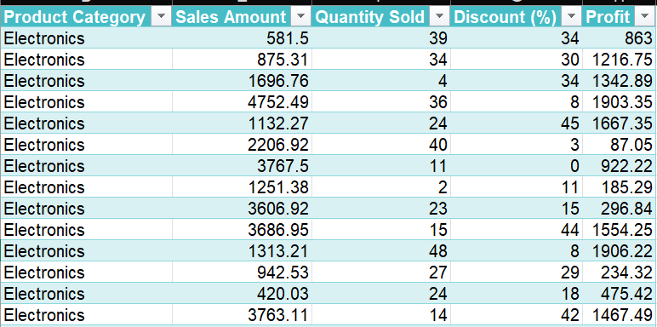
Used Power Query for Searching and Filtering Data
Data – Get & Transform Data – Load from Table
In Power Query Editor – Filtering for Region “South”, Product Category –”Electronics” for the year 2024
Loaded data back in Excel.

Slide 5
Used Power Query for Merging Data
Data – Get & Transform Data – Load from Table
In Power Query Editor – Created a new query named ‘Average Sales’
Group by: Region, New column name: Average Sales, Operation: Average, Column: Sales Amount.
Merge Queries – Region – Left Outer.
Loaded data back in Excel.
Order ID | Order Date | Region | Product Category | Sales Amount | Quantity Sold | Discount (%) | Profit | Region Average.AverageSales
ab899d2f | 06-04-2023 00:00 | North | Groceries | 859.29 | 44 | 37 | 1653.87 | 2573.119554
73484eb1 | 30-04-2024 00:00 | West | Groceries | 1546.81 | 23 | 33 | 1932.71 | 2535.998906
19395924 | 12-03-2024 00:00 | East | Groceries | 4703.58 | 31 | 15 | 527.47 | 2507.726068
b3fded3d | 09-02-2024 00:00 | East | Groceries | 3377.17 | 47 | 3 | 482.65 | 2507.726068

Slide 6
Task 4:
Calculate total sales for each region using the SUM formula.
=SUMIFS(Sales Amount,Region,”North”)
b. Compute the average discount percentage and profit for the "Furniture" category using AVERAGE.
=AVERAGEIFS(Discount,Product Category,"Furniture")
=AVERAGEIFS(Profit,Product Category,"Furniture")
Region | Total Sales
North | ₹ 25,39,669.00
South | ₹ 24,94,411.28
East | ₹ 25,95,496.48
West | ₹ 24,80,206.93
Metric | Value
Avg Discount % | ₹ 25.23
Avg Profit | ₹ 1,023.38

Slide 7
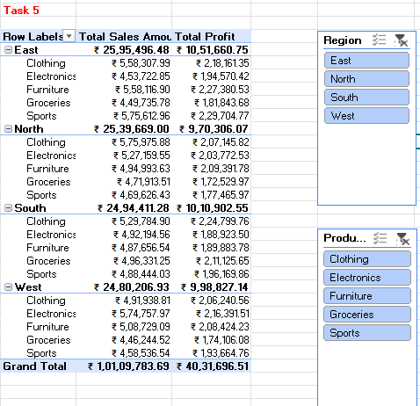
Task 5:
Create a Pivot Table to summarize total sales and profit by region and product category. Add slicers to filter by region or category dynamically.
Observation:
East region recorded the highest sales (₹25.95 lakh) and profit (₹10.51 lakh).
South and North regions followed closely with ₹24.94 lakh and ₹25.39 lakh in sales, respectively.
West region showed the lowest sales (₹24.80 lakh) and profit (₹9.98 lakh).
Clothing and Furniture together contribute over 40% of total sales, while Sports remains the least profitable category.

Slide 8
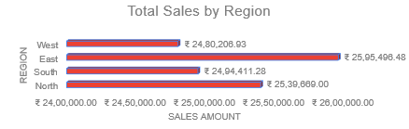
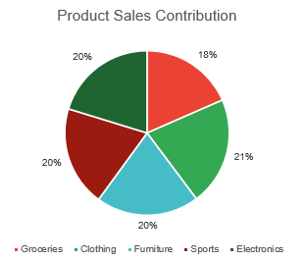
Total Sales by Region
East region recorded the highest sales of ₹25.95 lakh, indicating strong market performance.
West region showed the lowest sales (₹24.80 lakh), highlighting scope for improvement.
Product Sales Contribution
Electronics (21%) contributes the largest share to total sales.
Groceries (18%) has the smallest share, suggesting lower demand or limited inventory.
Overall Insights
Focus marketing and sales strategies on improving West region and Groceries category performance.
Maintain and strengthen Electronics sales, which are driving the company’s top-line growth.
Task 6:

Slide 9
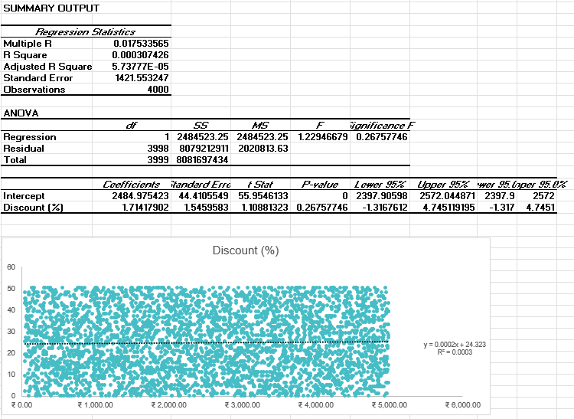
Task 7:
Perform a simple regression analysis to understand the impact of Discount (%) on Sales Amount. Use a scatter plot to visualize the relationship.
Observations
R² = 0.0003 → almost no link between discount and sales.
p-value (0.27) → discount impact not significant.
Small positive slope (1.71) → minimal sales change with discount.
Insights
Increasing discounts does not meaningfully boost sales.
Focus should shift from offering discounts to enhancing marketing, product value, or regional targeting, which may have a stronger influence on sales performance.

Slide 10
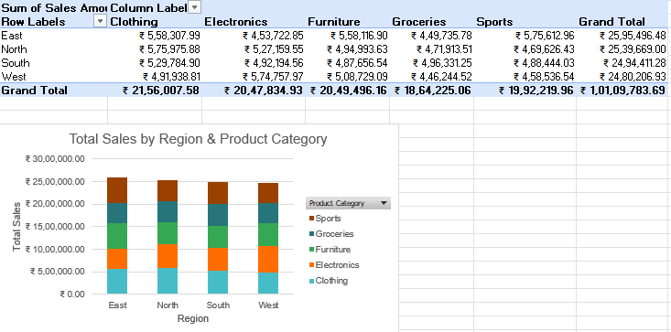
Task 8:
Create a stacked bar chart showing total sales by region and product category.
South and West regions lead in total sales, each exceeding ₹26 lakh.
Clothing and Electronics are top-selling categories, driving the bulk of revenue across all regions.

Slide 11
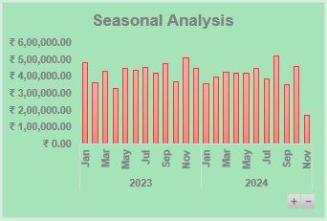
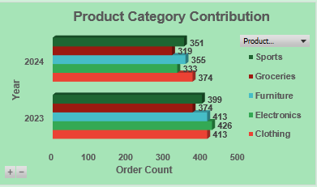
Task 9:
Seasonal Analysis
Peak sales occurred around March, August, and November, showing festive or seasonal demand.
Sales dip significantly toward year-end months like December and January.
Product Category Contribution
Order counts dropped in 2024 across all categories compared to 2023.
Clothing and Electronics lead in both years, showing strong customer preference.

Slide 12
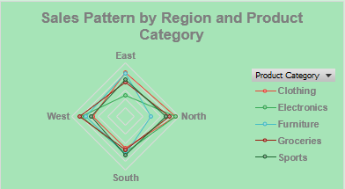
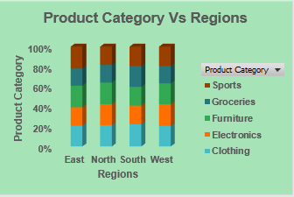
Task 9:
Sales Pattern by Region and Product Category
South and East regions consistently outperform others across all categories.
North region shows the lowest overall sales spread.
Product Category vs Regions
Clothing and Electronics dominate sales across all regions.
West and South have a more balanced contribution among product types.

Slide 13
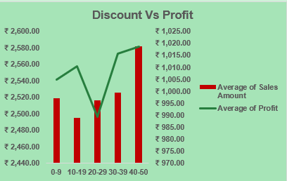
Task 9:
Moderate discounts (10–19%) may reflect a strategic pricing sweet spot, where customer interest is retained without significantly compromising profit margins.
The simultaneous decline in both sales and profit at higher discount levels suggests possible over-discounting, which could be devaluing the product or attracting low-margin transactions.

Slide 14
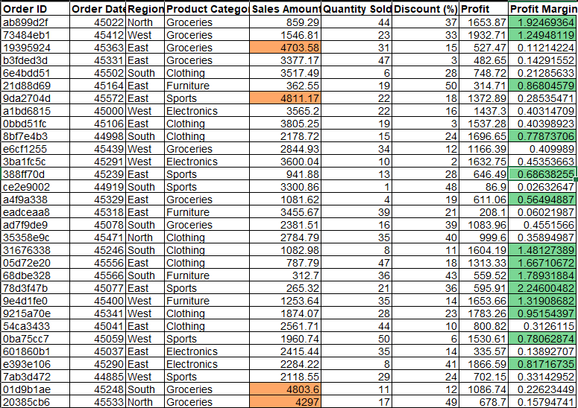
Task 10:
Conditional Formatting:
Use Formula where the (profit margin>0.5)
Colour Code to Highlight.
Second Formula where the (Sales Amount > 4000)
Different Colour coding.

Slide 15
Actionable Insights:
Prioritize High-Performing Regions:
Focus sales and marketing efforts on South and East regions, as they consistently record higher sales across categories.
Boost Key Product Categories:
Clothing and Electronics dominate across years and regions — expand inventory, introduce new models, and target repeat buyers in these categories.
Seasonal Promotion Strategy:
Plan discounts and campaigns in March, August, and November, when customer spending is highest, to maximize returns.
Optimize Discount Policies:
Regression analysis shows no strong link between discount and sales — reduce unnecessary discounting and redirect efforts toward value-driven promotions.
Recover Declining Product Performance:
Since 2024 saw a drop in order counts across categories, refresh underperforming product lines (like Furniture and Sports) with bundle offers or cross-category marketing.

